Slide 1
Information Retrieval Across Multiple Information Sources using a Knowledge-Based Methodology
Siddharth Taduri
Gloria T. Lau
Kincho H. Law
Jay P. Kesan

Slide 2
Problem Statement
Patent System
Technology Firms’ Concerns
Can I get patent protection for my innovation?
Do I build or do I buy related technologies?
What are my competitors doing?
How strong are their patents?
Am I perhaps infringing on someone else’s patents?
Is so, are those patents valid?
Have they been enforced in court?
Has their validity been challenged in court?
Issued Patents and Applications
File Wrappers
Court Cases
Technical Publications
Regulations and Laws

Slide 3
Patents Documents
United States Patent 5,955,422: “Production of Erthropoietin” September 21, 1999 Abstract Disclosed are novel polypeptides possessing part or all of the primary structural conformation … of mammalian erythropoietin ("EPO") … polynucleotides in a heterologous cellular or viral sample prepared from, e.g., DNA present in a plasmid or viral-borne cDNA or genomic DNA "library“… Inventors: Lin; Fu-Kuen (Thousand Oaks, CA) Assignee: Kirin-Amgen, Inc. (Thousand Oaks, CA) … Claims A pharmaceutical composition comprising a therapeutically effective amount of human erythropoietin … Description ….

Slide 4
Court Cases
927 F.2d 1200 (1991)
AMGEN, INC., Plaintiff/Cross-Appellant, v. CHUGAI PHARMACEUTICAL CO., LTD., and Genetics Institute, Inc., Defendants-Appellants.
Nos. 90-1273, 90-1275.
United States Court of Appeals, Federal Circuit.
March 5, 1991.
Suggestion for Rehearing Declined May 20, 1991.
…
…
Before MARKEY, LOURIE and CLEVENGER, Circuit Judges.
…
THE PATENTS
On June 30, 1987, the United States Patent and Trademark Office (PTO) issued to Dr. Rodney Hewick U.S. Patent 4,677,195, entitled "Method for the Purification of Erythropoietin and Erythropoietin Compositions" (the '195 patent). The patent claims both homogeneous EPO and compositions thereof and a method for purifying human EPO using reverse phase high performance liquid chromatography. The method claims are not before us. The relevant claims of the '195 patent are:
Homogeneous erythropoietin characterized by a molecular weight of about 34,000 daltons on SDS PAGE, movement as a single peak on reverse phase high performance liquid chromatography and a specific activity of at least 160,000 IU per absorbance unit at 280 nanometers.
* * * * * *
A pharmaceutical composition for the treatment of anemia comprising a therapeutically effective amount of the homogeneous erythropoietin of claim 1 in a pharmaceutically acceptable vehicle.
Homogeneous erythropoietin characterized by a molecular weight of about 34,000 daltons on SDS PAGE, movement as a single peak on reverse phase high performance liquid chromatography and a specific activity of at least about 160,000 IU per absorbance unit at 280 nanometers.
Notes:
Alternatives to download searchable court cases include LexisNexis and Google Scholar

Slide 5
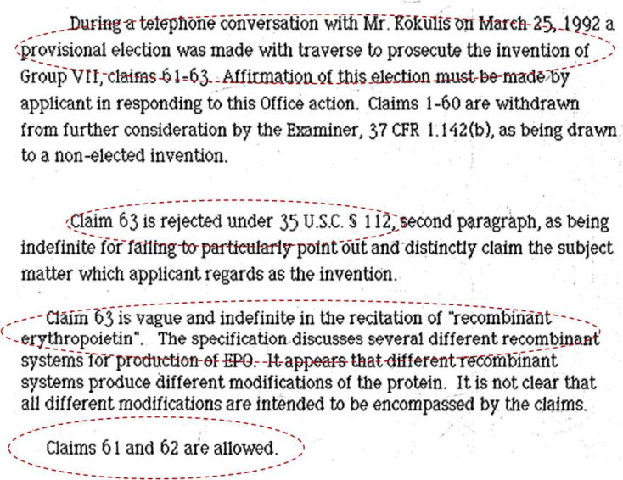
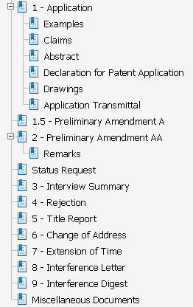
Patent File Wrappers
Text
Events

Slide 6
Scientific Publications
<PubmedArticle>
<MedlineCitation Owner="NLM" Status="MEDLINE">
<PMID>10022466</PMID>
<DateCreated>
<Year>1999</Year> <Month>02</Month> <Day>25</Day>
</DateCreated>
….
<Article PubModel="Print">
<Journal>
….
<JournalIssue CitedMedium="Print">
<Volume>84</Volume> <Issue>2</Issue>
….
</JournalIssue>
<Title>The Journal of clinical endocrinology and metabolism</Title>
<ISOAbbreviation>J. Clin. Endocrinol. Metab.</ISOAbbreviation>
</Journal>
<ArticleTitle>About the use … of an ACTH 1-39 ….</ArticleTitle>
….

Slide 7
Cross-Referencing
COURT CASE
314 F.3d 1313 (2003)
AMGEN INC., Plaintiff-Cross Appellant v. HOECHST MARION ROUSSEL, INC. (now known as Aventis Pharmaceuticals, Inc.) and Transkaryotic Therapies, Inc., Defendants-Appellants.
…
Plaintiff-Cross Appellant Amgen Inc. is the owner of numerous patents directed to the production of erythropoietin ("EPO"), …alleging that TKT's Investigational New Drug Application ("INDA") infringed United States Patent Nos. 5,547,933; 5,618,698; and 5,621,080. The complaint was amended in October 1999 to include United States Patent Nos. 5,756,349 and 5,955,422, which issued after suit was filed.
REGULATIONS:
U.S. Code Title 35, C. F. R Title 37, M. P. E. P. …
Publication Database
FILE WRAPPER
U.S. Patent 5,955,422
…
Claims 61-63 are rejected under 35 U.S.C. § 103 as being unpatentable over any one of Miyake et al., 1977 (R)
…
In accordance with the provisions of 37 C.F.R. §1.607, the present continuation is being filed for the purpose of
…
PATENT
United States Patent, 5,955,422
September 21, 1999
Production of erthropoietin
Abstract: Disclosed are novel polypeptides possessing part or all of the primary structural conformation and one or more of the biological properties of mammalian erythropoietin ("EPO") …
Inventors: Lin; Fu-Kuen (Thousand Oaks, CA)
Assignee: Kirin-Amgen, Inc. (Thousand Oaks, CA) Appl. No.: 08/100,197
Filed: August 2, 1993.
BIOPORTAL: DOMAIN KNOWLEDGE
Solution: Patent System Ontology

Slide 8
Domain Terminology
PMID: 12897095
Regional variability in the incidence of end-stage renal disease: an epidemiological approach.
….
Regional variability in the incidence of end-stage renal disease (ESRD) in Austria is reported. Our aim was …. low rates in the state of Tyrol.
….
ESRD incidence data were obtained from ….
….
Between 1995 and 1999, 4811 new cases of ESRD were recorded; the state of Tyrol (T) …. incidence of ESRD patients with type 2 diabetes mellitus …. the difference in the overall ESRD incidence …. prevalence of DM, a highly significant correlation was found between ESRD incidence and DM.
….
variability in the ESRD incidence in Austria is explained mainly by regional differences in DM-2. Data from similar studies …. allocation for ESRD ….
….

Slide 9
Domain Ontologies
National Drug File (NDF)
Preferred Name | Kidney Failure, Chronic
Synonyms | End Stage Kidney Disease … Renal Disease, End Stage …. Renal Failure, End Stage …. Kidney Disease, Chronic Renal Failure, Chronic End-Stage Kidney Disease ESRD Renal Disease, End-Stage Renal Failure, End-Stage Chronic Kidney Failure Chronic Renal Failure
ID | C3678
Diseases, Manifestations or …
Urological and Male Genital Diseases
Urological Diseases
Kidney Diseases
Renal Insufficiency
Renal Insufficiency, Chronic
Kidney Failure
Kidney Failure, Chronic

Slide 10
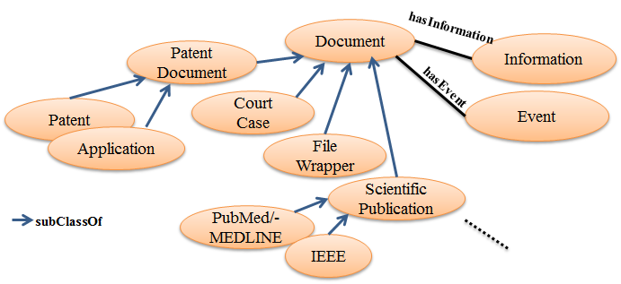
Goals
Facilitate information integration across multiple diverse information sources
This requires a standardized representation (a formal semantic model) - Patent System Ontology
Integrate Domain Semantics into existing Information Retrieval and Text mining methodologies to improve retrieval of information

Slide 11
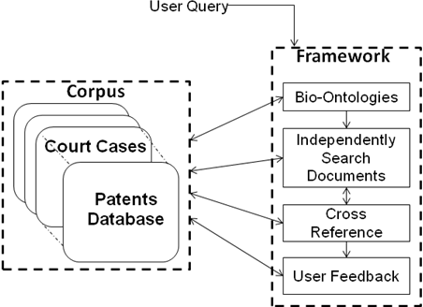
Information Retrieval Framework
Patent System Ontology

Slide 12
Demo?

